Slide 1
Chapter2 Boolean Algebra and Logic Gates

Slide 2
Boolean Algebra
Definition
Like any other deductive mathematical systems
A set of elements, a set of operators
A number of unproved axioms or postulates

Slide 3
Basic Definitions
Postulates (axioms) of mathematical system
Closure : A set S is closed with respect to a binary operator if, for every pair of elements of S, the binary operator specifies a rule for obtaining a unique elements of S.
Associative law (x*y)*z = x*(y*z) for all x, y, z ∈ S
Commutative law x*y = y*x for all x, y ∈ S
Identity element e*x = x*e = x for every x ∈ S
Inverse x*y = e
Distributive law x*(y⋅z) = (x*y)⋅(x*z)

Slide 4
Axiomatic Definition of Boolean Algebra
Huntington Postulates
(a) Closure with respect to the operator +
(b) Closure with respect to the operator ⋅
(a) An identity element with respect to the operator +, designed by 0: 0+x=x+0=x
(b) An identity element with respect to the operator ⋅, designed by 1: 1⋅x=x⋅1=x
(a) commutative with respect to the operator +: x+y =y+x
(b) commutative with respect to the operator ⋅ : x ⋅ y =y⋅x
4. (a) ⋅ is distributive over +: x ⋅ (y + z) = (x ⋅ y) + (x ⋅ z)
(a) + is distributive over ⋅: x + (y ⋅ z) = (x + y) ⋅ (x + z)
For every element x ∈ B, there exists an element x′ ∈ B (the complement of x) s.t. (a) x + x′ = 1 and (b) x ⋅ x′ = 0.
There exists at least two elements x, y ∈ B s.t. x ≠ y.

Slide 5
Differences between Boolean and Ordinary Algebra
Huntington postulates do not include the associative law. → this law holds for Boolean algebra.
The distributive law of + over ⋅ is valid for Boolean algebra, not for ordinary algebra.
Boolean algebra does not have additive or multiplicative inverse.
Complement is not available in ordinary algebra.
Ordinary algebra → real number: infinite
Boolean algebra → only two value {0, 1}

Slide 6
Two-valued Boolean Algebra
x y x · y
0 0 0
0 1 0
1 0 0
1 1 1
x y x + y
0 0 0
0 1 1
1 0 1
1 1 1
x x′
0 1
1 0
Exactly same as the AND, OR, and NOT.
Binary (two-argument) operator: AND, OR
Unary (one-argument) operator: NOT
Mush show that the Huntington postulates are valid for {0, 1}
Postulate1: Closure
Postulate2: From the tables,
0+0=0 0+1=1+0=1; → two identity element , 0 for + and 1 for ·
1 · 1 = 1 1 · 0 = 0 · 1 = 0
Postulate3: The commutative law is obvious.
Postulate4: The distributive law holds true for two operator: from the truth tables.
Postulate5: From the complement table
Postulate6 is satisfied because only two values exist.

Slide 7
Basic Theorems and Properties of Boolean Algebra
Duality
One part may be obtained from the other if the binary operators and the identity elements are interchanged.
The left and right columns of axioms are duals
interchange all ANDs with ORs, and 0s with 1s
Show Table 2.1

Slide 8
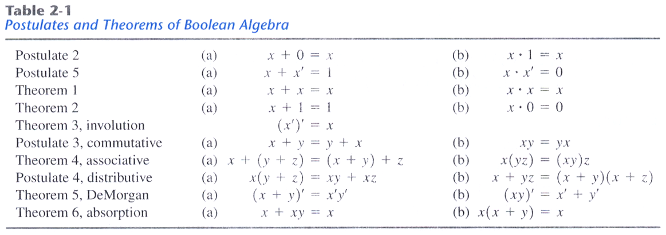
Basic Theorem
Duality
Operator Precedence
Parentheses
NOT
AND
OR

Slide 9
Are these postulates for real?
We can show that these postulates are true, given the definitions of AND, OR and NOT
These postulates are easy to see from these truth tables alone. For example, x + x’ = 1 because of the middle two lines below (where y = x’)

Slide 10
Some more laws
Here are some more useful laws. Notice the duals again!
We can prove these laws by either
Making truth tables:
Using the axioms:
x + x’y = (x + x’)(x + y) [ Distributive ]
= 1 • (x + y) [ x + x’ = 1 ]
= x + y [ Postulate 2 ]

Slide 11
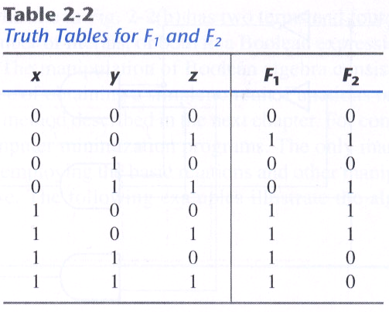
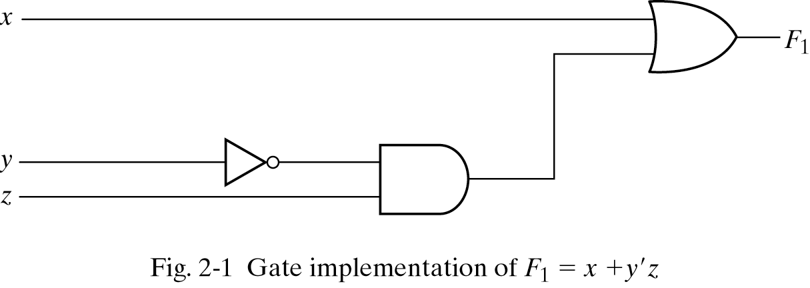
Boolean Functions
F1 = x + y'z

Slide 12
Simplification of Boolean Function
We can now start doing some simplifications
F2 = x'y'z + x'yz +xy'
= x'z(y'+y) + xy'
= x'z + xy'

Slide 13
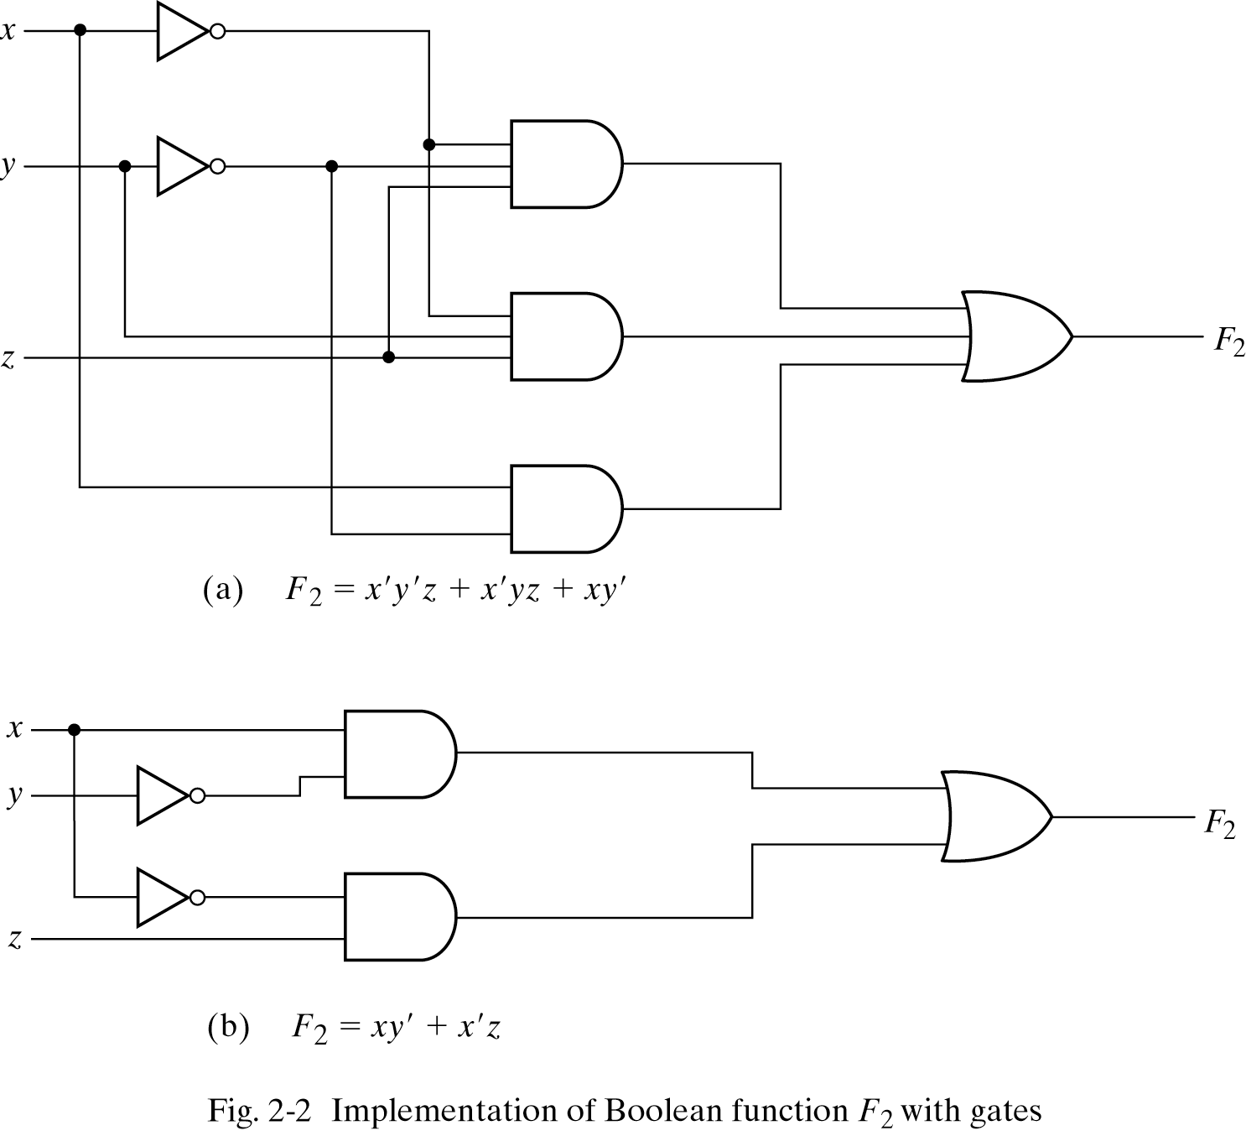
Let’s compare the resulting circuits
Here are two different but equivalent circuits.
In general the one with fewer gates is “better”:
It costs less to build
It requires less power
But we had to do some work to find the second form

Slide 14
Algebraic Manipulation
Example 2-1: simplifying Boolean functions
x(x'+y) = xx' + xy = 0 + xy = xy.
x +x'y = (x+x')(x+y) = 1(x+y) = x + y.
(x+y)(x+y') = x + xy + xy' + yy' = x(1+y+y') = x.
xy + x'z + yz = xy + x'z + yz(x+x')
= xy + x'z + xyz + x'yz = xy(1+z) + x'z(1+y)
= xy + x'z
5. (x+y)(x'+z)(y+z) = (x+y)(x'+z)
by duality from function 4.

Slide 15
Complement of a Function
You can use DeMorgan’s law to keep “pushing” the complements inwards
You can also take the dual of the function, and then complement each literal
If f(x,y,z) = x(y’z’ + yz)…
…the dual of f is x + (y’ + z’)(y + z)…
…then complementing each literal gives x’ + (y + z)(y’ + z’)…
…so f’(x,y,z) = x’ + (y + z)(y’ + z’)
General
(A+B+C+D+…+F)' = A'B'C'D'…F'
(ABCD…F)' = A' +B'+ C' + D' + … + F'
f(x,y,z) = x(y’z’ + yz)
f’(x,y,z) = ( x(y’z’ + yz) )’ [ complement both sides ]
= x’ + (y’z’ + yz)’ [ because (xy)’ = x’ + y’ ]
= x’ + (y’z’)’ (yz)’ [ because (x + y)’ = x’ y’ ]
= x’ + (y + z)(y’ + z’) [ because (xy)’ = x’ + y’, twice]

Slide 16
Proving DeMorgan’s Law
We can make up truth tables to prove (both parts of) DeMorgan’s law
For (x + y)’ = x’y’, we can make truth tables for (x + y)’ and for x’y’
In each table, the columns on the left (x and y) are the inputs. The columns on the right are outputs.
In this case, we only care about the columns in blue. The other “outputs” are just to help us find the blue columns.
Since both of the columns in blue are the same, this shows that (x + y)’ and x’y’ are equivalent

Slide 17
Minterms
A minterm is a special product of literals, in which each input variable appears exactly once.
A function with n variables has 2^{n} minterms (since each variable can appear complemented or not)
A three-variable function, such as f(x,y,z), has 2³ = 8 minterms:
Each minterm is true for exactly one combination of inputs:
x’y’z’ x’y’z x’yz’ x’yz
xy’z’ xy’z xyz’ xyz
Minterm Is true when… Shorthand
x’y’z’ x=0, y=0, z=0 m₀
x’y’z x=0, y=0, z=1 m₁
x’yz’ x=0, y=1, z=0 m₂
x’yz x=0, y=1, z=1 m₃
xy’z’ x=1, y=0, z=0 m₄
xy’z x=1, y=0, z=1 m₅
xyz’ x=1, y=1, z=0 m₆
xyz x=1, y=1, z=1 m₇

Slide 18
Sum of Minterms Form
Every function can be written as a sum of minterms, which is a special kind of sum of products form
The sum of minterms form for any function is unique
If you have a truth table for a function, you can write a sum of minterms expression just by picking out the rows of the table where the function output is 1.
f = x’y’z’ + x’y’z + x’yz’ + x’yz + xyz’
= m₀ + m₁ + m₂ + m₃ + m₆
= Σ(0,1,2,3,6)
f’ = xy’z’ + xy’z + xyz
= m₄ + m₅ + m₇
= Σ(4,5,7)
f’ contains all the minterms not in f

Slide 19
Maxterms
A maxterm is a sum of literals, in which each input variable appears exactly once.
A function with n variables has 2^{n} maxterms
The maxterms for a three-variable function f(x,y,z):
Each maxterm is false for exactly one combination of inputs:
x’ + y’ + z’ x’ + y’ + z x’ + y + z’ x’+ y + z
x + y’ + z’ x + y’ + z x + y + z’ x + y + z
Maxterm Is false when… Shorthand
x + y + z x=0, y=0, z=0 M₀
x + y + z’ x=0, y=0, z=1 M₁
x + y’ + z x=0, y=1, z=0 M₂
x + y’ + z’ x=0, y=1, z=1 M₃
x’ + y + z x=1, y=0, z=0 M₄
x’ + y + z’ x=1, y=0, z=1 M₅
x’ + y’ + z x=1, y=1, z=0 M₆
x’ + y’ + z’ x=1, y=1, z=1 M₇

Slide 20
Product of maxterms form
Every function can be written as a unique product of maxterms
If you have a truth table for a function, you can write a product of maxterms expression by picking out the rows of the table where the function output is 0. (Be careful if you’re writing the actual literals!)
f = (x’ + y + z)(x’ + y + z’)(x’ + y’ + z’)
= M₄ M₅ M₇
=  ∏(4,5,7)
f’ = (x + y + z)(x + y + z’)(x + y’ + z)
(x + y’ + z’)(x’ + y’ + z)
= M₀ M₁ M₂ M₃ M₆
=  ∏(0,1,2,3,6)
f’ contains all the maxterms not in f

Slide 21
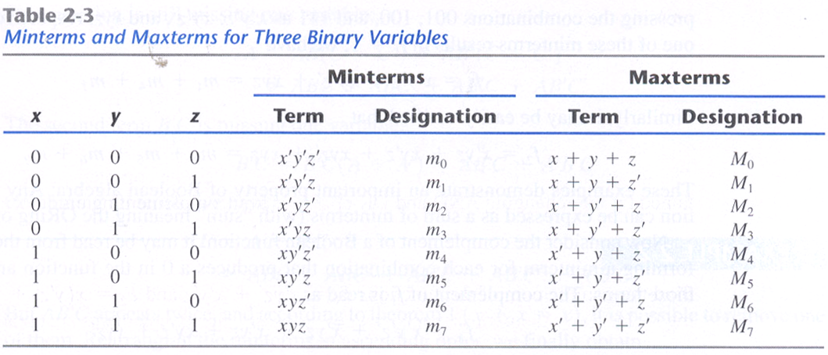
Minterms and maxterms are related
Any minterm m_{i} is the complement of the corresponding maxterm M_{i}
For example, m₄’ = M₄ because (xy’z’)’ = x’ + y + z

Slide 22
Converting between standard forms
We can convert a sum of minterms to a product of maxterms
In general, just replace the minterms with maxterms, using maxterm numbers that don’t appear in the sum of minterms:
The same thing works for converting from a product of maxterms to a sum of minterms
From before f = Σ(0,1,2,3,6)
and f’ = Σ(4,5,7)
= m₄ + m₅ + m₇
complementing (f’)’ = (m₄ + m₅ + m₇)’
so f = m₄’ m₅’ m₇’ [ DeMorgan’s law ]
= M₄ M₅ M₇ [ By the previous page ]
= ∏(4,5,7)
f = Σ(0,1,2,3,6)
= ∏(4,5,7)

Slide 23
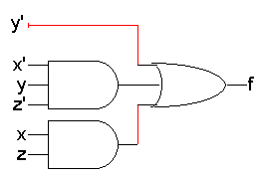
Standard forms of expressions
We can write expressions in many ways, but some ways are more useful than others
A sum of products (SOP) expression contains:
Only OR (sum) operations at the “outermost” level
Each term that is summed must be a product of literals
The advantage is that any sum of products expression can be implemented using a two-level circuit
literals and their complements at the “0th” level
AND gates at the first level
a single OR gate at the second level
This diagram uses some shorthands…
NOT gates are implicit
literals are reused
A product of sums expressing → duality
f(x,y,z) = y’ + x’yz’ + xz

Slide 24
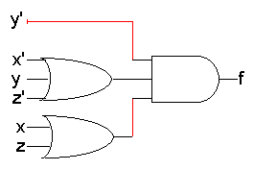
The dual idea: products of sums
Just to keep you on your toes...
A product of sums (POS) expression contains:
Only AND (product) operations at the “outermost” level
Each term must be a sum of literals
Product of sums expressions can be implemented with two-level circuits
literals and their complements at the “0th” level
OR gates at the first level
a single AND gate at the second level
Compare this with sums of products
f(x,y,z) = y’ (x’ + y + z’) (x + z)

Slide 25
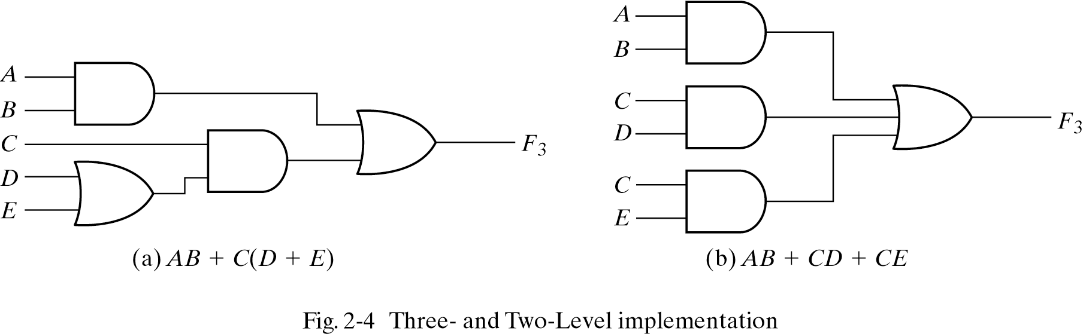
Standard Forms
Delay through gates !

Slide 26
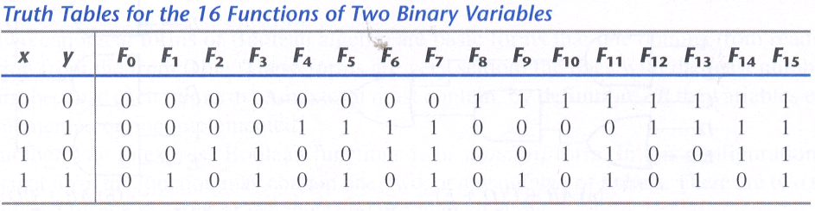
Other Logic Operations

Slide 27
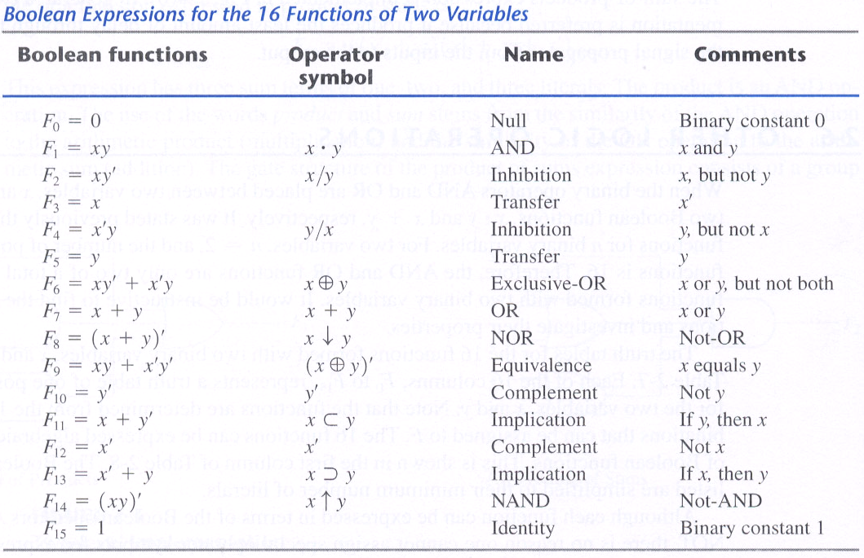
Other Logic Operations (2)

Slide 28
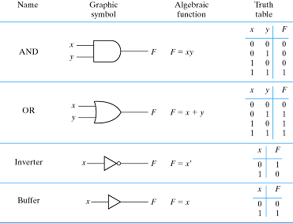
Digital Logic Gates

Slide 29
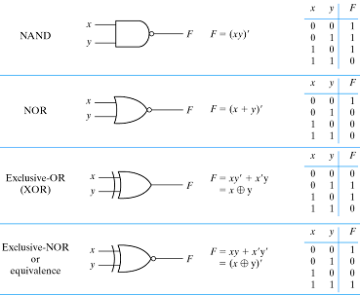
Digital Logic Gates (2)

Slide 30
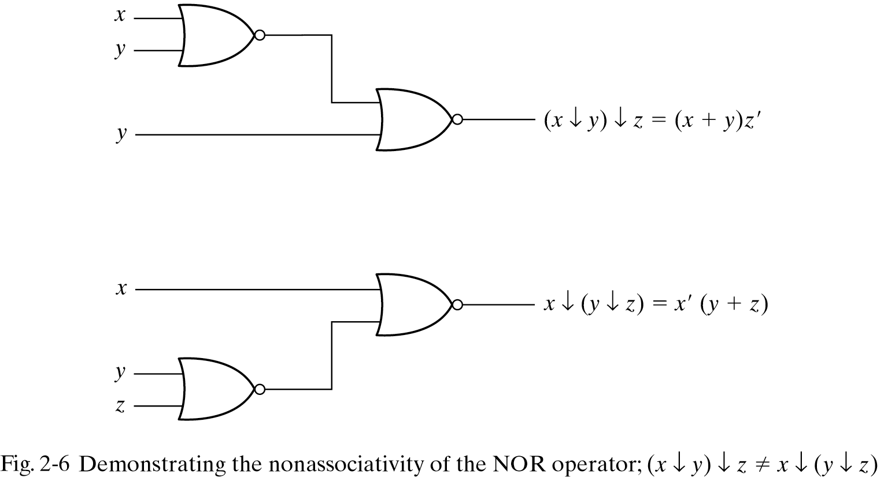
Extension to Multiple Inputs
Difficulty
Not associative for NAND and NOR
→ (x↓y)↓z≠x↓(y↓z)
(x↓y)↓z= [(x+y)'+z]' = (x+y)z'= xz' + yz'
x↓(y↓z)= [x+(y+z)']' = x'(y+z)= x'y + x'z
z

Slide 31
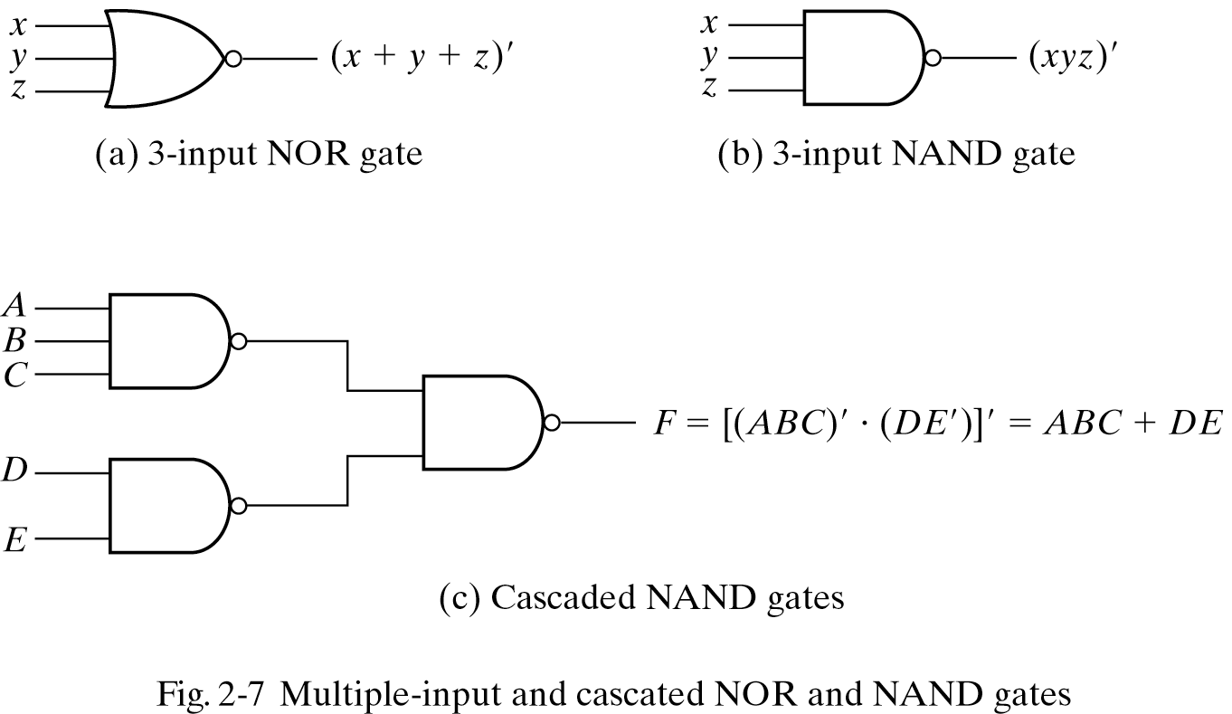
Extension of Multiple Inputs
x↓y↓z= (x+y+z)'
x↑y↑z= (xyz)'

Slide 32
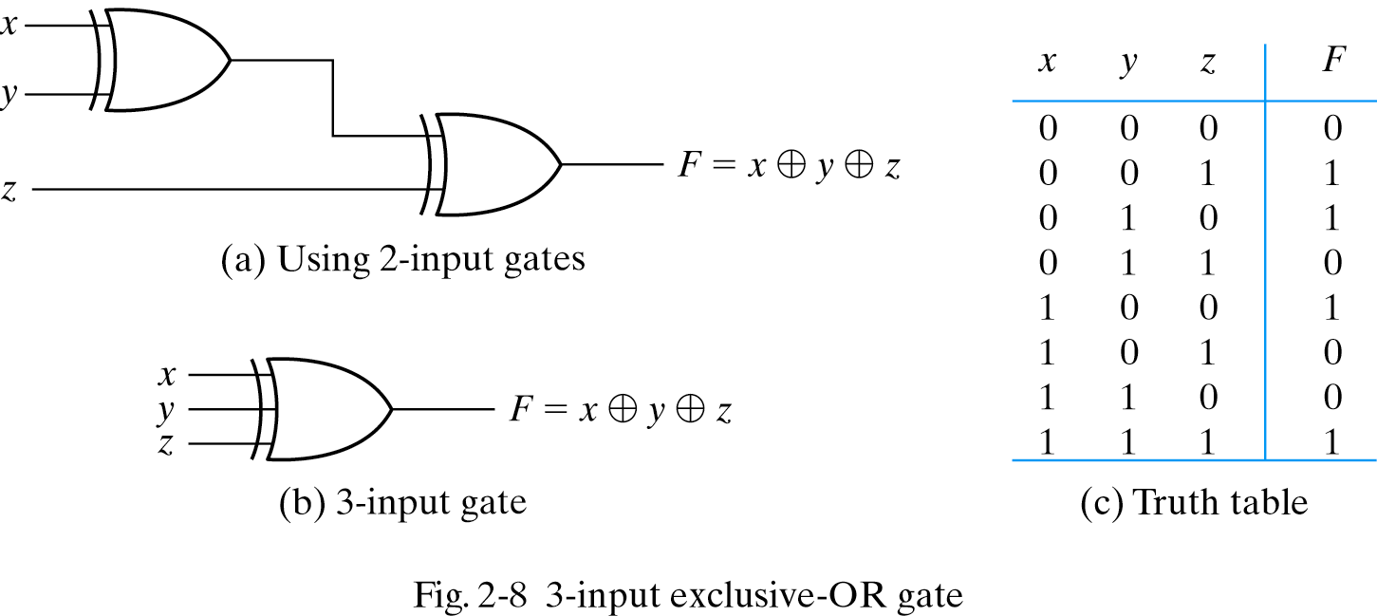
Exclusive-OR

Slide 33
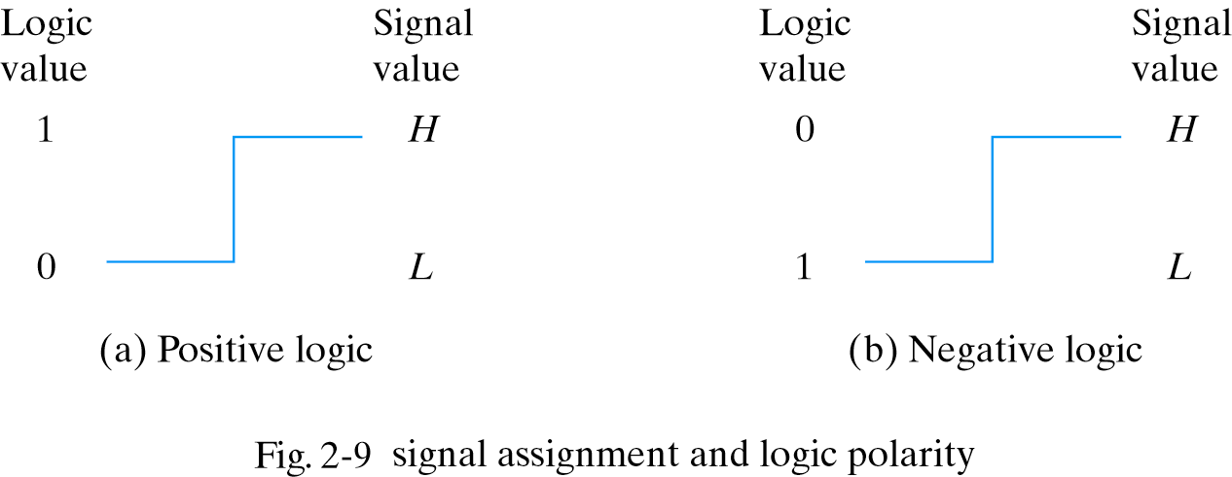
Positive and Negative Logic

Slide 34
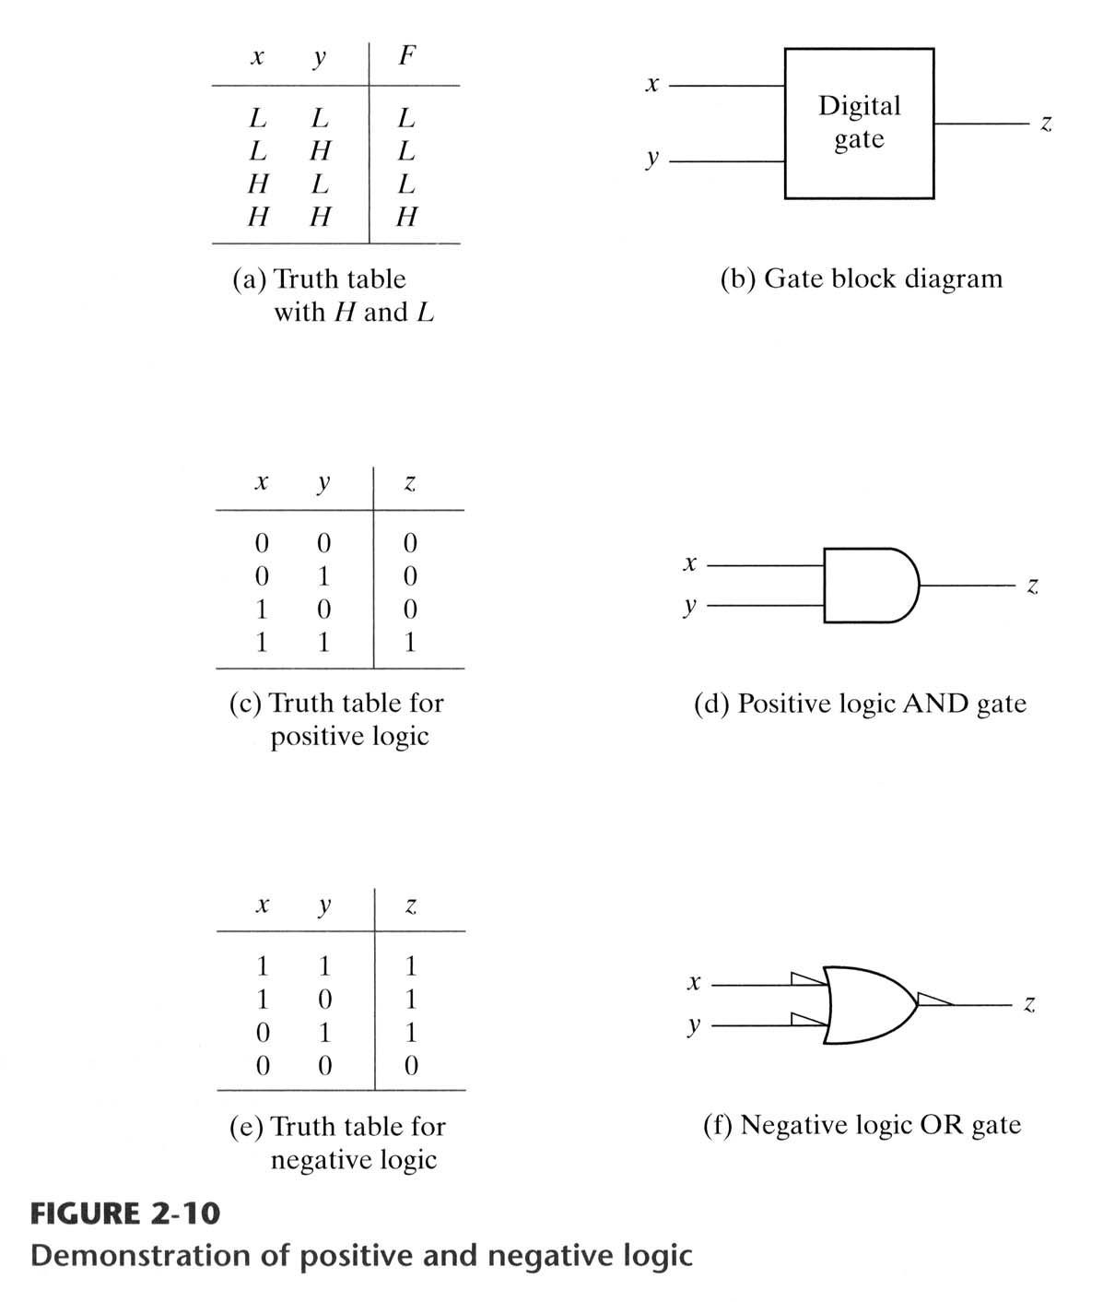

Slide 35
Integrated Circuits (IC)
Levels
SSI
MSI: 10~1,000 gates
LSI: thousands of gates
VLSI: hundreds thousands of gates
Digital Logic Families
TTL: transistor-transistor logic
ECL: emitter-coupled logic
MOS: Metal-oxide semiconductor
CMOS : Complementary metal-oxide semiconductor
References
Fan-out
Fan-in
Power dissipation
Propagation delay
Noise margin

Slide 36
Summary
So far:
A bunch of Boolean algebra trickery for simplifying expressions and circuits
The algebra guarantees us that the simplified circuit is equivalent to the original one
Introducing some standard forms and terminology
Next:
An alternative simplification method
We’ll start using all this stuff to build and analyze bigger, more useful, circuits

